Slide 1
Jméno autora: Mgr. Mária Filipová
Datum vytvoření: 24. 09. 2013
Číslo DUMu: VY_32_INOVACE_20_AJ_FT
Ročník: 1. – 4. ročník
Vzdělávací oblast: Jazyk a jazyková komunikace
Vzdělávací obor: Anglický jazyk
Tematický okruh: odborná slovní zásoba a témata pro studenty oboru Aplikovaná chemie
Téma: Let´s defend against infections
Klíčová slova: bacteria, viruses, immunity, white blood cells
Metodický list/anotace:
Materiál slouží k seznámení se základní odbornou slovní zásobou pro studenty oborů Aplikovaná chemie. Jedná se zejména o termíny z oblasti biologie a chemie.
Studenti odhadují na základě svých znalostí význam slov. V případě potřeby pracují se slovníkem. Důležité je pochopení obsahu a aktivní slovní zásoba . Studenti využívají svých znalostí z oboru chemie, biologie a mikrobiologie.
Připraví krátkou prezentaci se zajímavými informacemi.

Slide 2
Defending against infections

Slide 3
Pathogens
Pathogens are microorganisms that cause disease.
Bacteria and viruses are the main types of pathogen.
Transmission of pathogens occurs through many different routes, including airborne, direct or indirect contact, sexual contact, through blood, breast milk, or other body fluids, and through the fecal-oral route.

Slide 4
Bacteria
Bacteria are microscopic organisms. Bacteria are living cells and in favourable conditions they can multiply rapidly. Once inside the body, they release poisons or toxins that make us feel ill. Diseases caused by bacteria include:
food poisoning
cholera
typhoid
whooping cough

Slide 5
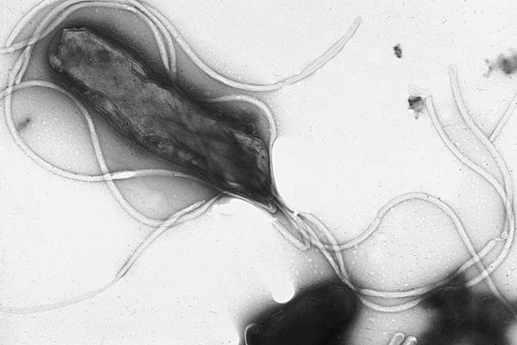
Bacteria – pic.1
Helicobacter pyroli

Slide 6
Viruses
Viruses are among the smallest organisms known and consist of a fragment of genetic material inside a protective protein coat.
Viruses can only reproduce inside host cells and they damage the cell when they do this. A virus gets inside a cell and then make thousands of copies of itself. The viruses are then passed out in the bloodstream, the airways, or by other routes.

Slide 7
Diseases caused by viruses
influenza (flu)
colds
measles
mumps
rubella
chicken pox
AIDs

Slide 8
White blood cells
destroy pathogens
produce antibodies to destroy particular pathogens
produce antitoxins that counteract the toxins released by pathogens
white blood cells do not eat the pathogens - they ingest them
antibodies and antitoxins are not living things - they are specialised proteins

Slide 9
Immunity
Pathogens contain certain chemicals that are foreign to the body. These chemicals are called antigens. Certain white blood cells, called lymphocytes, can produce specific antibodies to kill a particular pathogen.
Antibodies are proteins. They can neutralise pathogens in a number of ways. They can bind to pathogens and damage or destroy them, they coat pathogens, clumping them together so that they are easily ingested by white blood cells called phagocytes.

Slide 10
Phagocytes
see:
http://www.youtube.com/watch?v=cD_uAGPBfQQ
http://www.youtube.com/watch?v=CEOV-SFTlpY

Slide 11
Zdroje
pic. 1 - YUTAKA TSUTSUMI, M.D.. en.wikipedia.org [online]. [cit. 24.09.2013]. Dostupný na WWW: http://en.wikipedia.org/wiki/File:EMpylori.jpg

Slide 12
Literatura
BETINA, Vladimír a kol. Malá encyklopédia Biologie. Bratislava: Obzor, 1975, ISBN 65-023-75.
http://en.wikipedia.org
PHILLIPS, Janet a kol. Oxford studijní slovník. Oxford: Oxford University Press, 2010, ISBN 978019 430655 3.

