Slide 1
Jméno autora: Mgr. Olga Bayerlová
Datum vytvoření: 22.04.2013
Číslo DUMu: VY_32_INOVACE_20_AJ3E
Ročník: II.
Anglický jazyk
Vzdělávací oblast: Jazyk a jazyková komunikace
Vzdělávací obor: Anglický jazyk
Tematický okruh: Stravování
Téma: V restauraci
Metodický list/anotace: Prezentace určená pro opakování pomocí projekce PC nebo formou vytištění pracovního listu s následnou kontrolou. Vhodné k procvičování a doplnění slovní zásoby.

Slide 2
At a restaurant
waiter/waiteress: What can I do for you?
customer: Menu, please.
w: Could I recommend you today‘s offer?
c: It would be nice.
w: Tomato juice to start, then roastbeef and green peas.
c: That sounds fine. Do you have a dessert?
w: Yes, of course. Apple pie and custard. Maybe cheese and biscuits to finish the meal with.
c: Ok. And a cup of strong coffee without milk, please.
w: As you wish.

Slide 3
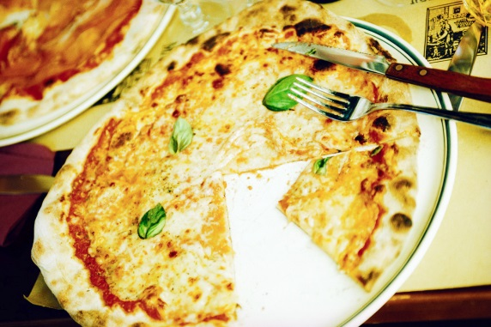

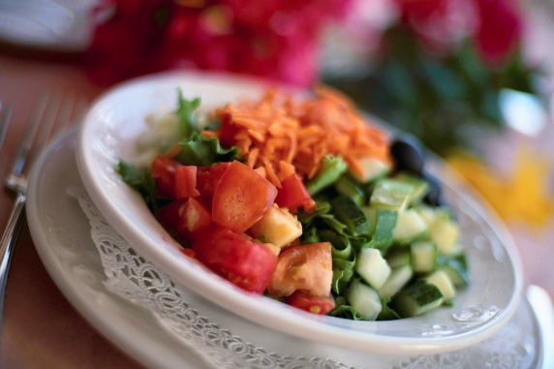
Where do you usually go, when, whom and why?
café / coffeehouse
restaurant
fast food
pub
Chinese restaurant
snack bar
self-service restaurant
all-you-can-eat
take-away
pizza restaurant

Slide 4
Answer these questions
What‘s your favourite:
  starter?
  soup?
  main dish?
  dessert?
Which food don‘t you eat at all (hate)?
Is Czech cuisine healthy/unhealthy - and why?
Have you ever cooked dinner for your family/friends?
(What was it and how long did it take?)
How do you help your parents in the kitchen?
How often do you go eating out?
How much do you spend on eating out a month?
Compare English and Czech quisine (breakfast, lunch, dinner).

Slide 5
Citace:
Zdroj obrázků: MS Office, Verze: 14.0.6129.5000 (64bitová verze)

