Slide 1
Jméno autora: Mgr. Olga Bayerlová Datum vytvoření: 22.04.2013
Číslo DUMu: VY_32_INOVACE_17_AJ1G
Ročník: II.
Anglický jazyk
Vzdělávací oblast: Jazyk a jazyková komunikace
Vzdělávací obor: Anglický jazyk
Tematický okruh: Budoucí čas
Téma: Vazba „going to“
Metodický list/anotace: Prezentace určená pro výklad a opakování pomocí projekce PC nebo formou vytištění pracovního listu s následnou kontrolou.

Slide 2
Future with going to
I‘m going to bake a cake.
You‘re going to study.
They‘re going to work.
Going to
He‘s going to sleep.
We‘re going to sing.
She‘s going to paint.
It‘s going to rain.

Slide 3
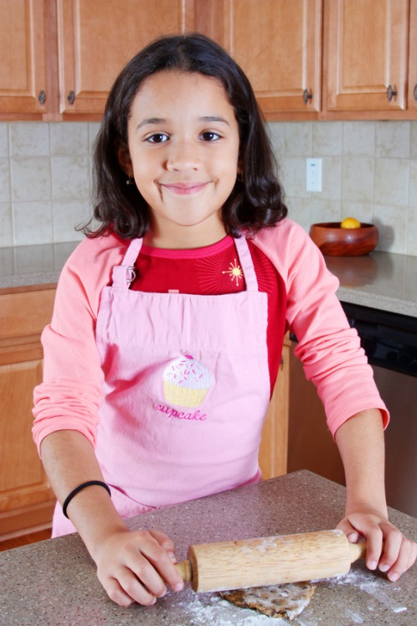
Plans for the future Singular
the present simple of be + going to + the base form of the verb
1 2 3 4
Susan is going to bake.
2 1 3 4
Is Susan going to bake?
+ Yes, she is.
+ Yes, she‘s going to bake.
- No, she isn‘t. - No, she isn‘t going to bake.

Slide 4
Plans for the future Plural
the present simple of be + going to + the base form of the verb
1 2 3 4
They are going to swim.
2 1 3 4
Are they going to swim?
+ Yes, they are.
+ Yes, they‘re going to swim.
- No, they aren‘t. - No, they aren‘t going to swim.

Slide 5
Excercise Write a question with going to for each situation.
Your brother is going to the theatre. You ask:
(what/wear)……………………………………………..
Your parents are going to visit London. You ask:
(when/visit)…………………………………………...……..
Your teacher is going to call your father. You ask:
(why/call)………………………………………………………
Your friend is going to look for a job. You ask:
(where/look for)……………………………………………

Slide 6
Solution Write a question with going to for each situation.
Your brother is going to the theatre. You ask:
What are you going to wear?
Your parents are going to visit London. You ask:
When are you going to visit London?
Your teacher is going to call your father. You ask:
Why are you going to call my father?
Your friend is going to look for a job. You ask:
Where are you going to look for a job?

Slide 7
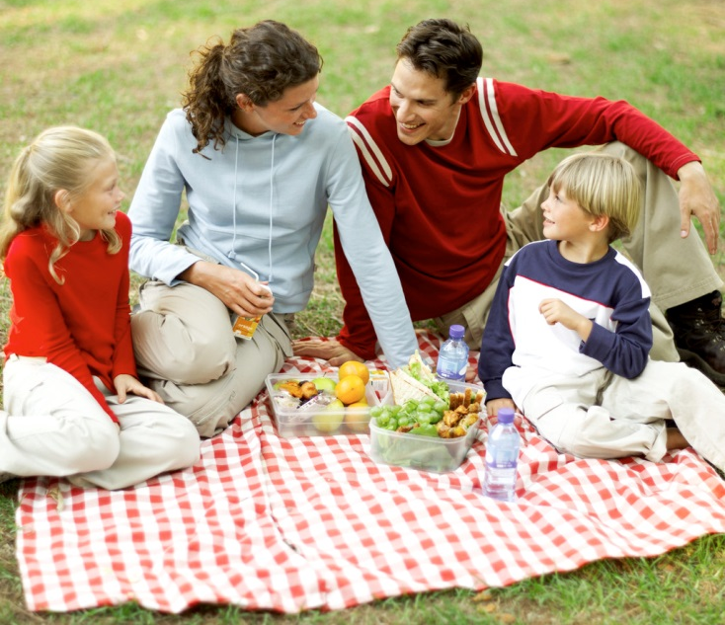
Translate
Co se Brownovi chystají dělat o víkendu?
Brownovi se chystají pořádat narozeninovou party.
Paní Brownová hodlá upéct dort.
Pan se chystá grilovat.
Dcera se chystá pomáhat v kuchyni.
Syn se chystá pozvat kamarády.

Slide 8
Solution
What are the Browns going to do at the weekend?
The Browns are going to have a birthday party.
Mrs.Brown is going to bake a birthday cake.
Mr. Brown is going to grill.
Their daughter is going to help in the kitchen.
Their son is going to invite his friends.

Slide 9
Citace:
Zdroj obrázků: MS Office, Verze: 14.0.6129.5000 (64bitová verze)

