Slide 1
Jméno autora: Mgr. Olga Bayerlová
Datum vytvoření: 22.04.2013
Číslo DUMu: VY_32_INOVACE_15_AJ1G
Ročník: II.
Anglický jazyk
Vzdělávací oblast: Jazyk a jazyková komunikace
Vzdělávací obor: Anglický jazyk
Tematický okruh: Slovesné časy
Téma: Předpřítomný čas
Metodický list/anotace: Prezentace určená pro výklad a opakování pomocí projekce PC nebo formou vytištění pracovního listu s následnou kontrolou.

Slide 2
Present perfect
Singular
I have bought a car.
You have written a postcard.
She has brought a letter.
He has played tennis.
It has gone.

Slide 3
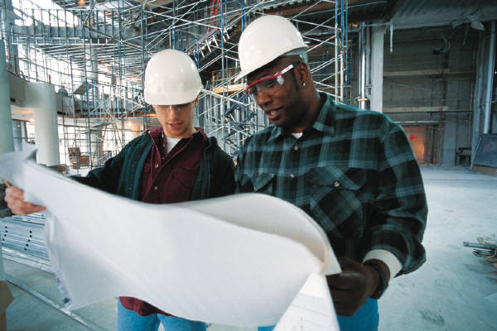
Present perfect
Plural
We have read.
You have worked.
They have sang.

Slide 4
Present perfect
Regular verbs
play | played | played
work | worked | worked
arrive | arrived | arrived
Irregular verbs
write | wrote | written
sing | sang | sung
bring | brought | brought

Slide 5
Questions and answers
Singular
1
2
3
She has brought a letter.
2
1
3
Has she brought a letter?
+ Yes, she has.
+ Yes, she‘s brought a letter.
- No, she hasn‘t.
- No, she hasn‘t brought a letter.

Slide 6
Questions and answers
Plural
1
2
3
They have sung a song.
2
1
3
Have they sung a song?
+ Yes, they have.
+ Yes, they‘ve sung a song.
- No, they haven‘t.
- No, they haven‘t sung a song.

Slide 7
Excercise
Translate
Dáš si něco k pití?
Právě jsem vypil sklenici vody.
Znáš našeho nového studenta?
Už jsme se potkali.
Půjdeš s námi do kina?
Už jsem ten film viděl.

Slide 8
Excercise
Solution
Would you like something to drink?
I have drank a glass of water just now.
Do you know our new student?
We have already met.
Are you going to the cinema with us?
I‘ve already seen this film.

Slide 9
Citace:
Zdroj obrázků: MS Office, Verze: 14.0.6129.5000 (64bitová verze)

