Slide 1
Jméno autora: Mgr. Mária Filipová
Datum vytvoření: 16. 09. 2013
Číslo DUMu: VY_32_INOVACE_13_AJ_FT
Ročník: 1. – 4. ročník
Vzdělávací oblast: Jazyk a jazyková komunikace
Vzdělávací obor: Anglický jazyk
Tematický okruh: odborná slovní zásoba a témata pro studenty oboru Aplikovaná chemie
Téma: Fungi and mold – Aspergillum, Penicillium
Klíčová slova: Penicillium, Aspergilum, fungi, mold, toxicity, aflatoxin
Metodický list/anotace:
Materiál slouží k seznámení se základní odbornou slovní zásobou pro studenty oborů Aplikovaná chemie. Jedná se zejména o termíny z oblasti biologie a chemie.
Studenti odhadují na základě svých znalostí význam slov. V případě potřeby pracují se slovníkem. Důležité je pochopení obsahu a aktivní slovní zásoba . Studenti využívají svých znalostí z oboru chemie, biologie a mikrobiologie.
Připraví krátkou prezentaci se zajímavými informacemi.

Slide 2
Fungi and mold
Penicillium
Aspergillus

Slide 3
Aspergillus
Aspergillus is a genus consisting of several hundred mould species found in various climates worldwide.
Aspergillus was first catalogued in 1729 by the Italian biologist Pier Antonio Micheli. Viewing the fungi under a microscope, Micheli was reminded of the shape of an aspergillum (holy water sprinkler), from Latin spargere (to sprinkle), and named the genus accordingly.
Aspergillus species are highly aerobic and are found in almost all oxygen-rich environments, where they commonly grow as molds on the surface of a substrate. Fungi grow on substrates like glucose or amylose. Aspergillus species are common contaminants of starchy foods (such as bread and potatoes), and grow on many plants.

Slide 4
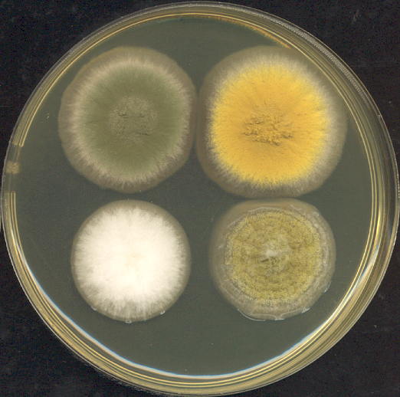
Aspergillus colonies – pic. 1

Slide 5
Pathogens
Some Aspergillus species cause serious disease in humans and animals. The most common pathogenic species are A. fumigatus and A. flavus, which produces aflatoxin which is both a toxin and a carcinogen, and which can contaminate foods such as nuts. Some species cause allergic disease, other species are agricultural pathogens(cause disease on many grain crops, especially maize).

Slide 6
Penicillium
Penicillium is a genus of fungi of major importance in the natural environment as well as food and drug production.
Members of the genus produce penicillin, a molecule that is used as an antibiotic, which kills or stops the growth of certain kinds of bacteria inside the body, the widespread genus contains over 300 species.

Slide 7
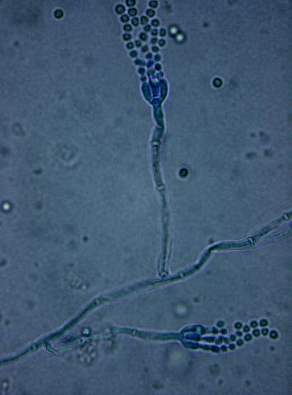
Penicillium under microscopy – pic.2

Slide 8
Penicillium value
Penicillium molds are found in Blue cheese. Penicillium camemberti and Penicillium roqueforti are the molds on Camembert, Brie, Roquefort, and many other cheeses. Penicillium nalgiovense is used to improve the taste of sausages and hams, and to prevent colonization by other molds and bacteria.
Species of Penicillium and Aspergillus serve in the production of biotechnologically produced enzymes and citric, and tartaric acids, also pectinases, lipase, amylases, cellulases, and proteases.
The genus includes a wide variety of species molds that are the source molds of major antibiotics. Penicillin was accidentally discovered by Alexander Fleming in 1929, and found to inhibit the growth of Gram positive bacteria .

Slide 9
Zdroje
pic. 1 - HUNTER, Adrian J.. en.wikipedia.org [online]. [cit. 16.09.2013]. Dostupný na WWW: http://en.wikipedia.org/wiki/File:Four_3-day_old_Aspergillus_colonies_on_a_Petri_dish.png
pic.2 - DR. SAHAY. en.wikipedia.org [online]. [cit. 16.09.2013]. Dostupný na WWW: http://en.wikipedia.org/wiki/File:Penicillium_Spp..jpg

Slide 10
Literatura
BETINA, Vladimír a kol. Malá encyklopédia Biologie. Bratislava: Obzor, 1975, ISBN 65-023-75.
http://en.wikipedia.org
PHILLIPS, Janet a kol. Oxford studijní slovník. Oxford: Oxford University Press, 2010, ISBN 978019 430655 3.

