Slide 1
Jméno autora: Mgr. Olga Bayerlová Datum vytvoření: 22.04.2013
Číslo DUMu: VY_32_INOVACE_13_AJ3E
Ročník: II.
Anglický jazyk
Vzdělávací oblast: Jazyk a jazyková komunikace
Vzdělávací obor: Anglický jazyk
Tematický okruh: Nakupování
Téma: Způsoby nakupování
Metodický list/anotace: Prezentace určená pro opakování pomocí projekce PC nebo formou vytištění pracovního listu s následnou kontrolou. Vhodné k procvičování a doplnění slovní zásoby.

Slide 2
Types of shops
Where can you buy…?
bread
vegetables
books
furniture
meat
soap
shoes
clothes
electronics
trips
petrol
pencil

Slide 3
Types of shops Solution
Where can you buy…?
bread - baker‘s
vegetables - greengrocer‘s
books - bookshop
furniture - furniture store
meat - butcher‘s
soap - chemist‘s
shoes - shoe shop
clothes - clothing store
electronics - electro store
trips - travel agency
petrol - petrol station
pencil - stationery shop

Slide 4
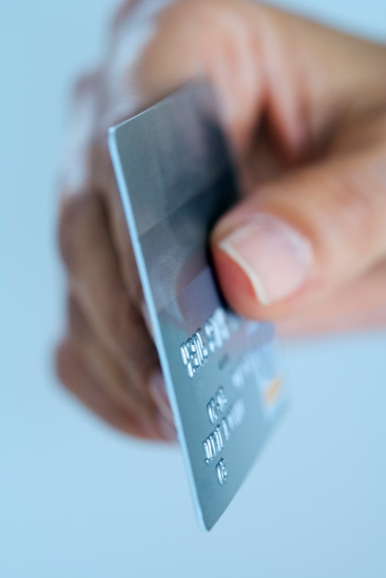
Shopping questionnaire
Do you like shopping?
Where do you do your shopping?
Who do you often go shopping with?
What do you like buying?
How do you pay?
How often do you buy over the internet?
Why do you like/dislike online shopping?
What can we buy online?
Write advantages/disadvantages of shopping in shopping centres and small shops.

Slide 5
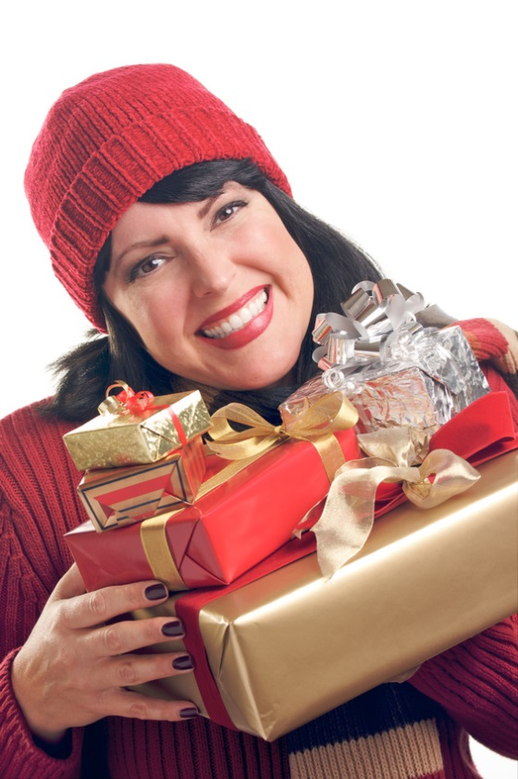
Homework
Prepare a dialogue with your schoolmate. You have got an invitation to a birthday party. It‘s necessary to buy a present for the birthday person.
Suggest the present.
Why that present?
Where can you buy it?
How much can you spend on it?
When will you go shopping?
Where will you meet?
What will you say to the birthday person?

Slide 6
Citace:
Zdroj obrázků: MS Office, Verze: 14.0.6129.5000 (64bitová verze)

