Slide 1
Jméno autora: Mgr. Mária Filipová
Datum vytvoření: 16. 09. 2013
Číslo DUMu: VY_32_INOVACE_12_AJ_FT
Ročník: 1. – 4. ročník
Vzdělávací oblast: Jazyk a jazyková komunikace
Vzdělávací obor: Anglický jazyk
Tematický okruh: odborná slovní zásoba a témata pro studenty oboru Aplikovaná chemie
Téma: Penicillin
Klíčová slova: Penicillin, mold , Alexander Fleming, antibiotics
Metodický list/anotace:
Materiál slouží k seznámení se základní odbornou slovní zásobou pro studenty oborů Aplikovaná chemie. Jedná se zejména o termíny z oblasti biologie a chemie.
Studenti odhadují na základě svých znalostí význam slov. V případě potřeby pracují se slovníkem. Důležité je pochopení obsahu a aktivní slovní zásoba . Studenti využívají svých znalostí z oboru chemie, biologie a mikrobiologie.
Připraví krátkou prezentaci se zajímavými informacemi.

Slide 2
Penicillin
Alexander Fleming

Slide 3
Penicillin
Penicillin antibiotics are historically significant because they are the first drugs that were effective against many previously serious diseases, such as syphilis, and infections caused by staphylococci and streptococci. Penicillins are still widely used today, though many types of bacteria have now become resistant.
Penicillin (sometimes abbreviated PCN or pen) is a group of antibiotics derived from Penicillium fungi.

Slide 4
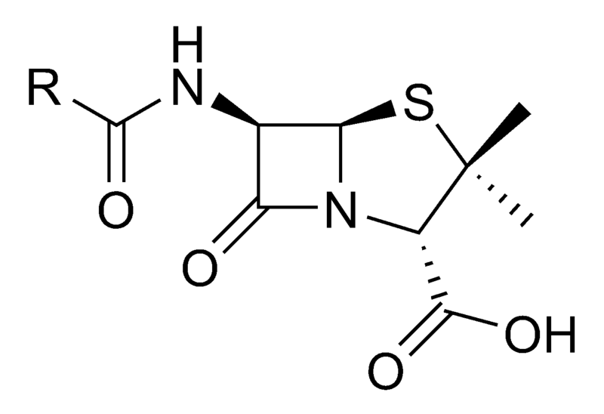
Penicillin core structure - pic.1
R is the variable group

Slide 5
Discovery
The discovery of penicillin is attributed to Scottish scientist and Nobel laureate Alexander Fleming in 1928.
Fleming recounted that the date of his discovery of penicillin was on the morning of Friday, September 28, 1928.It was an accident: in his laboratory he noticed a Petri dish containing Staphylococcus plate culture he mistakenly left open, was contaminated by blue-green mould, which formed a visible growth. There was a halo of inhibited bacterial growth around the mould. Fleming concluded the mould released a substance that repressed the growth and lysing the bacteria. He grew a pure culture and discovered it was a Penicillium mould, now known to be Penicillium notatum.

Slide 6
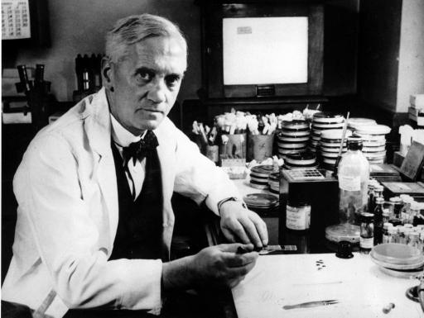
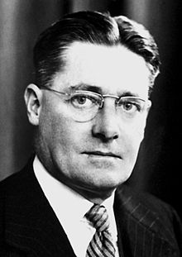
Alexander Fleming - pic.2

Slide 7
Medical application and mass production
Penicillin was found to be most effective against Gram-positive bacteria, and ineffective against Gram-negative organisms and fungi.
The chemical structure of penicillin was determined by Dorothy Crowfoot Hodgkin in 1945.Penicillin has since become the most widely used antibiotic to date and is still used for many Gram-positive bacterial infections.
Chemist John C. Sheehan at the Massachusetts Institute of Technology completed the first chemical synthesis of penicillin in 1957.
The first major development was ampicillin, which offered a broader spectrum of activity than either of the original penicillins.
Another development of the line of true penicillins was the antipseudomonal penicillins, such as carbenicillin, ticarcillin, and piperacillin, useful for their activity against Gram-negative bacteria.

Slide 8
Zdroje
pic.1 - YIKRAZUUL. en.wikipedia.org [online]. [cit. 16.09.2013]. Dostupný na WWW: http://en.wikipedia.org/wiki/File:Penicillin_core.svg
pic.2 - CALIBUON. en.wikipedia.org [online]. [cit. 16.09.2013]. Dostupný na WWW: http://en.wikipedia.org/wiki/File:Alexander_Fleming.jpg

Slide 9
Literatura
POLUNINOVÁ, Miriam; ROBBINS, Christopher. Liečivá z prírody. Bratislava: Gemini, 1994, ISBN 80-7161-098-4.
http://en.wikipedia.org
PHILLIPS, Janet a kol. Oxford studijní slovník. Oxford: Oxford University Press, 2010, ISBN 978019 430655 3.

