Slide 1
Jméno autora: Mgr. Olga Bayerlová Datum vytvoření: 22.04.2013
Číslo DUMu: VY_32_INOVACE_11_AJ1G
Ročník: I.
Anglický jazyk
Vzdělávací oblast: Jazyk a jazyková komunikace
Vzdělávací obor: Anglický jazyk
Tematický okruh: Přítomné časy
Téma: Přítomný čas prostý
Metodický list/anotace: Prezentace určená pro opakování pomocí projekce PC nebo formou vytištění pracovního listu s následnou kontrolou. Vhodné k procvičování po předcházejícím výkladu.

Slide 2
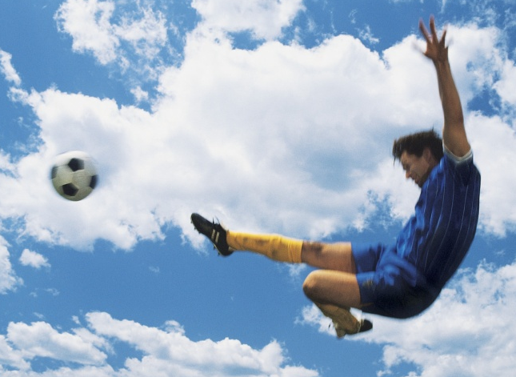
Present simple tense
"My name is Paul.
I'm a footballer.
I play football every day."
Her name is Caroline.
She is a gymnast.
She loves sport.
There are two colleagues.
They are policemen.
They work hard to protect you.

Slide 3
Questions
I play football every day.
Do you play football every day?
+ Yes, I do.
+ Yes, I play football every day.
- No, I don't. (do+not)
- No, I don't play football every day.
Policemen work hard.
Do they work hard?
+ Yes, they do.
+ Yes, they work hard.
- No, they don't. (do+not)
- No, they don't work hard.
Caroline loves sport.
Does she love sport?
+ Yes, she does.
+ Yes, she loves sport.
- No, she doesn't. (does+not)
- No, she doesn't love sport.

Slide 4
Singular
I
You
sing.
I
you
Do
sing?
+ Yes,…
- No,...
he
she
it
He
She
You
sings.
Does
sing?

Slide 5
Plural
We
You sing.
They
+ Yes,…
- No,...
We
You sing?
They
Do

Slide 6
Excercise Put the verb into the correct form
John .......... (drink) tea in the morning.
Children ............... (not write) letters every day.
Teachers often ................ (speak) with parents.
Jane ............... (not play) the guitar.
This gardener ............... (work) only in summer.
Form questions from these sentences.

Slide 7
Solution
John drinks tea in the morning.
Children don‘t write letters every day.
Teachers often speak with parents.
Jane doesn‘t play the guitar.
This gardener works only in summer.
Does John drink tea in the morning?
What don‘t children do every day?
Who do teachers often speak with?
Who doesn‘t play the guitar?
When does this gardener work?

Slide 8
Citace:
Zdroj obrázků: MS Office, Verze: 14.0.6129.5000 (64bitová verze)

