Slide 1
Jméno autora: Mgr. Olga Bayerlová Datum vytvoření: 22.04.2013
Číslo DUMu: VY_32_INOVACE_10_AJ1G
Ročník: II.
Anglický jazyk
Vzdělávací oblast: Jazyk a jazyková komunikace
Vzdělávací obor: Anglický jazyk
Tematický okruh: Minulý čas
Téma: Slovesa nepravidelná
Metodický list/anotace: Prezentace určená pro výklad pomocí projekce PC nebo formou vytištění pracovního listu s následnou kontrolou.

Slide 2
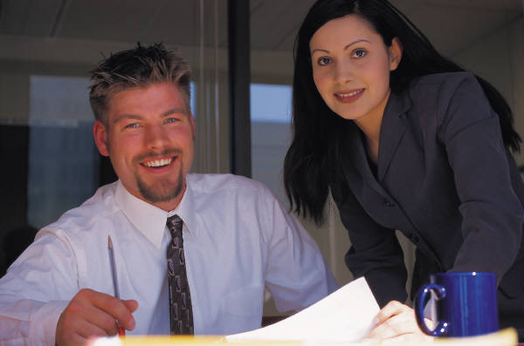
Past tense simple – irregular verbs
There are two colleagues.
They met two hours ago.
They went out four lunch.
They ate chicken curry.
They drank a glass of wine.
meet met met
go went gone
eat ate eaten
drink drank drunk

Slide 3
Questions
Jane met Tim.
Did Jane meet Tim?
+ Yes, she did. - No, she didn‘t.
+ Yes, she met Tim. - No, she didn‘t meet Tim.
They went out.
Did they go out?
+ Yes, they did. - No, they didn‘t.
+ Yes, they went out. - No, they didn‘t go out.
singular
plural

Slide 4
Translate
Tim a Jane spolu strávili dovolenou.
Hotel stál 50 liber na noc.
Koupili si výlet do hor.
Poslali svým přátelům pohlednici.
Napsali také krátký e-mail kolegům.
Vrátili se minulý týden.

Slide 5
Translate Solution
Tim and Jane spent their holiday together.
The hotel cost 50 pounds a night.
They bought a trip to the mountains.
They sent a postcard to their friends.
They wrote a short e-mail to their colleagues too.
They came back last week.
spend | spent | spent
cost | cost | cost
buy | bought | bought
send | sent | sent
write | wrote | written
come | came | come

Slide 6
Citace:
Zdroj obrázků: MS Office, Verze: 14.0.6129.5000 (64bitová verze)

