Slide 1
Jméno autora: Mgr. Olga Bayerlová
Datum vytvoření: 22.04.2013
Číslo DUMu: VY_32_INOVACE_09_AJ1G
Ročník: II.
Anglický jazyk
Vzdělávací oblast: Jazyk a jazyková komunikace
Vzdělávací obor: Anglický jazyk
Tematický okruh: Minulý čas
Téma: Slovesa pravidelná
Metodický list/anotace: Prezentace určená pro výklad pomocí projekce PC nebo formou vytištění pracovního listu s následnou kontrolou.

Slide 2
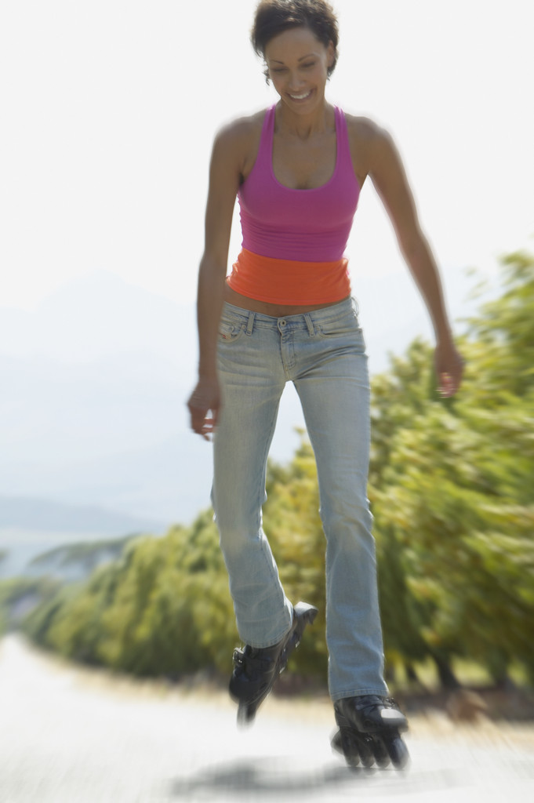
Past tense simple – regular verbs
This is Alice.
She was born in England.
She lived in London.
She studied at university.
She worked at primary school.
She stopped her job one year ago.
-ed
Live -> lived
Study -> studied
Work -> worked
Stop -> stopped

Slide 3
When did you work?
I
You
They
…yesterday
…a day before yesterday
…on Monday
…two weeks ago
…last year
…at the weekend
…in 2012
Worked
He
We
She
It

Slide 4
Questions
Tim played the guitar.
  Did Tim play the guitar?
  + Yes, he did. - No, he didn‘t.
  + Yes, he played the guitar. - No, he didn‘t play the guitar.
Mothers cooked dinner.
  Did mothers cook dinner?
  + Yes, they did. - No, they didn‘t.
  + Yes, they cooked dinner. - No, they didn‘t cook dinner.
singular
plural

Slide 5
Translate
Alice byla včera v parku.
Chtěla se sejít se svými přáteli.
Volala jim v pátek odpoledne.
Ale oni se dívali na hokej.
Tak se rozhodla jít na kolečkové brusle.
Pak se večer se učila.

Slide 6
Translate
Solution
Alice was in the park yesterday.
She wanted to meet her friends.
She called them on Friday afternoon.
But they watched ice-hockey.
So she decided to go rollerblading.
Then she studied in the evening.

Slide 7
Citace:
Zdroj obrázků: MS Office, Verze: 14.0.6129.5000 (64bitová verze)

