Slide 1
Jméno autora: Mgr. Mária Filipová
Datum vytvoření: 12. 09. 2013
Číslo DUMu: VY_32_INOVACE_08_AJ_FT
Ročník: 1. – 4. ročník
Vzdělávací oblast: Jazyk a jazyková komunikace
Vzdělávací obor: Anglický jazyk
Tematický okruh: odborná slovní zásoba a témata pro studenty oboru Aplikovaná chemie
Téma: Poisonous plants
Klíčová slova: poisonous, lethal, toxine, summer
Metodický list/anotace:
Materiál slouží k seznámení se základní odbornou slovní zásobou pro studenty oborů Aplikovaná chemie. Jedná se zejména o termíny z oblasti biologie a chemie.
Studenti odhadují na základě svých znalostí význam slov. V případě potřeby pracují se slovníkem. Důležité je pochopení obsahu a aktivní slovní zásoba . Studenti využívají svých znalostí z oboru chemie, biologie a mikrobiologie.
Připraví krátkou prezentaci se zajímavými informacemi.

Slide 2
Poisonous plants
summer

Slide 3
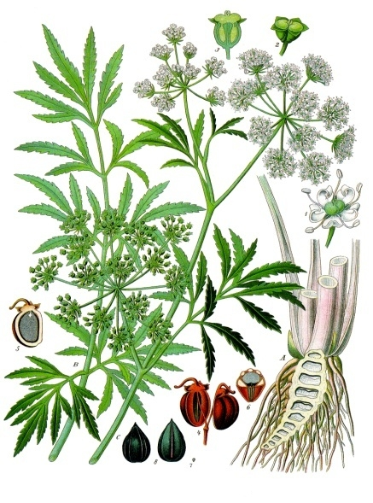
Cicuta virosa – pic. 1

Slide 4
Cicuta virosa
Cicuta virosa (Cowbane or Northern Water Hemlock) is a species native to northern and central Europe, northern Asia and northwestern North America. It is a perennial herbaceous plant which grows up to 1–2 m tall.
The plant contains cicutoxin, which disrupts the workings of the central nervous system. In humans, cicutoxin rapidly produces symptoms of nausea, emesis and abdominal pain, typically within 60 minutes of ingestion.
A single bite of the root (which has the highest concentration of cicutoxin) can be sufficient to cause death.

Slide 5
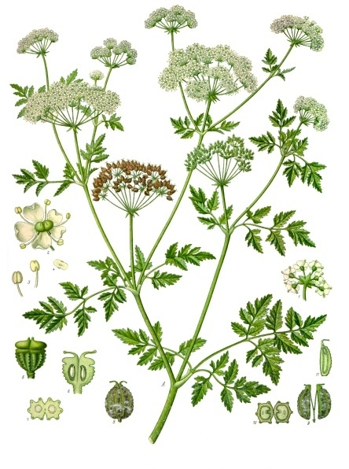
Conium maculatum - pic. 2

Slide 6
Conium maculatum
Conium is a genus of one or two species of highly poisonous perennial flowering plants in the family Apiaceae, native to Europe and the Mediterranean region.
The most noted of these chemicals is coniine, which has a chemical structure and pharmacological properties similar to nicotine. Coniine disrupts the workings of the central nervous system. In high enough concentrations Coniine can be dangerous to humans and livestock. Due to high potency, the ingestion of seemingly small doses can easily result in respiratory collapse and death.
In ancient Greece, hemlock was used to poison condemned prisoners. The most famous victim of hemlock poisoning is the philosopher Socrates.

Slide 7
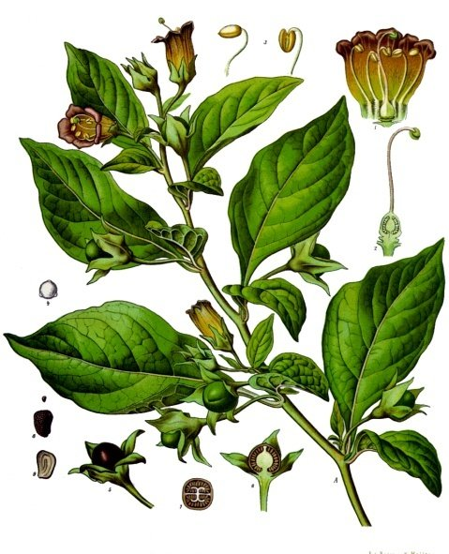
Atropa belladonna – pic.3

Slide 8
Atropa belladonna
Atropa belladonna is a perennial plant in the family Solanaceae, native to Europe, North Africa, and Western Asia. The foliage and berries are extremely toxic, containing tropane alkaloids. These toxins include scopolamine and hyoscyamine which cause a bizarre delirium and hallucinations. The drug atropine is derived from the plant.
It has a long history of use as a medicine, cosmetic, and poison. Before the Middle Ages, it was used as an anesthetic for surgery; the ancient Romans used it as a poison.
Belladonna is one of the most toxic plants found in the Eastern Hemisphere. All parts of the plant contain tropane alkaloids. The berries pose the greatest danger to children because they look attractive and have a somewhat sweet taste. The consumption of two to five berries by a human adult is probably lethal.

Slide 9
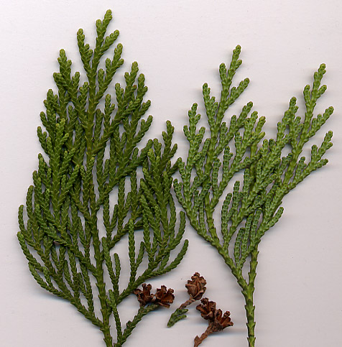
Thuja – pic.4

Slide 10
Thuja
Thuja is a genus of coniferous trees in the Cupressaceae (cypress family). There are five species in the genus, two native to North America and three native to eastern Asia.
Oil of thuja contains the terpene thujone with potentially lethal properties.

Slide 11
Other poisonous plants
Datura stramonium - Jimson weed or datura
Veratrum album - false helleborine, white hellebore
Ricinus - castor oil plant

Slide 12
Zdroje
pic. 1 - KOHLER, Franz Eugen. wikimedia.org/wikipedia [online]. [cit. 12.09.2013]. Dostupný na WWW: http://en.wikipedia.org/wiki/File:Cicuta_virosa_-_K%C3%B6hler%E2%80%93s_Medizinal-Pflanzen-038_cropped.jpg
pic. 2 - KOHLER, Franz Eugen. wikimedia.org/wikipedia [online]. [cit. 12.09.2013]. Dostupný na WWW: http://en.wikipedia.org/wiki/File:Conium_maculatum_-_K%C3%B6hler%E2%80%93s_Medizinal-Pflanzen-191.jpg
pic. 3 - KOHLER, Franz Eugen. wikimedia.org/wikipedia [online]. [cit. 12.09.2013]. Dostupný na WWW: http://en.wikipedia.org/wiki/File:Atropa_belladonna_-_K%C3%B6hler%E2%80%93s_Medizinal-Pflanzen-018.jpg
pic. 4 - AUTOR NEZNÁMY. wikimedia.org/wikipedia [online]. [cit. 12.09.2013]. Dostupný na WWW: http://en.wikipedia.org/wiki/File:Thuja_standishii.jpg

Slide 13
Literatura
POLUNINOVÁ, Miriam; ROBBINS, Christopher. Liečivá z prírody. Bratislava: Gemini, 1994, ISBN 80-7161-098-4.
KRESÁNEK, Jaroslav; KREJČA, Jindřich. Atlas liečivých rastlín a lesných plodov. Martin: Osveta, 1988, ISBN 70-056-88 ALR.
http://en.wikipedia.org
PHILLIPS, Janet a kol. Oxford studijní slovník. Oxford: Oxford University Press, 2010, ISBN 978019 430655 3.

