Slide 1
Jméno autora: Mgr. Mária Filipová
Datum vytvoření: 29. 08. 2013
Číslo DUMu: VY_32_INOVACE_01_AJ_FT
Ročník: 1. – 4. ročník
Vzdělávací oblast: Jazyk a jazyková komunikace
Vzdělávací obor: Anglický jazyk
Tematický okruh: odborná slovní zásoba a témata pro studenty oboru Aplikovaná chemie
Téma: The history of medicine
Klíčová slova: medicine, ancient methods, human body, treatment
Metodický list/anotace:
Materiál slouží k seznámení se základní odbornou slovní zásobou pro studenty oborů Aplikovaná chemie. Jedná se zejména o termíny z oblasti biologie a chemie.
Studenti odhadují na základě svých znalostí význam slov. V případě potřeby pracují se slovníkem. Důležité je pochopení obsahu a aktivní slovní zásoba . Studenti využívají svých znalostí z oboru chemie, biologie a mikrobiologie.
Připraví krátkou prezentaci se zajímavými informacemi.

Slide 2
The history of medicine - 1

Slide 3
Ancient civilisations
the ancient Egyptians had a system of medicine that was very advanced for its time and influenced later medical traditions
Egyptians developed a large and varied medical tradition
the oldest written records go to 3500 years ago

Slide 4
Traditional Chinese medicine
The philosophy of traditional Chinese medicine derived from empirical observations of disease and illness and reflects the Chinese belief that individual human experiences express principles in the environment. These principles, whether material, essential, or mystical, correlate as the expression of the natural order of the universe.
Traditional Chinese Medicine based on herbal medicine, acupuncture, massage and other forms of therapy has been practiced in China for thousands of years.

Slide 5
Yin and yang are ancient Chinese concepts
the concept of yin and yang is also applicable to the human body
the "Five Elements" theory, presumes that all phenomena of the universe and nature can be broken down into five elemental qualities
Chinese herbs have been used for centuries
From ancient times, pills were formed by combining several herbs and other ingredients, which were dried and ground into a powder. They were then mixed with a binder and formed into pills by hand. The binder was traditionally honey.

Slide 6
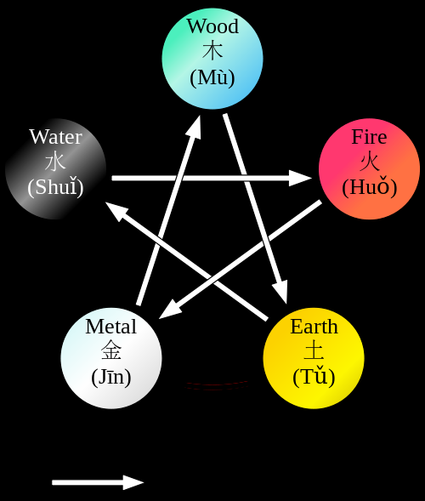
Chinese elements – pic. 1

Slide 7
India
the traditional medicine system known as Ayurveda, means the “complete knowledge for long life”
the student of Āyurveda was expected to know ten arts: the preparation and application of his medicines, distillation, operative skills, cooking, horticulture, metallurgy, sugar manufacture, pharmacy, analysis and separation of minerals, compounding of metals and preparation of alkalis

Slide 8
Greek medicine
The most important figure in the history of medicine was the physician Hippocrates of Kos ( 460 – c. 370 BCE ), he is considered to be the “father of modern medicine“
the ancient Greeks developed a medicine system where treatment sought to restore the balance within the body

Slide 9
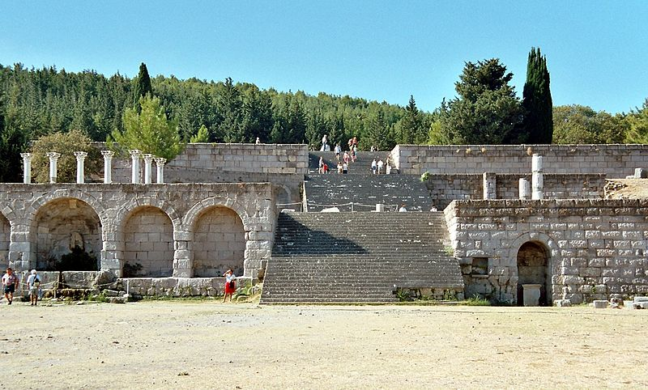
Aesklepeion – pic. 2

Slide 10
Zdroje
Pic.1 - WUXING. /500px-Wuxing_en.svg.png [online]. [cit. 29.08.2013]. Dostupný na WWW: http://en.wikipedia.org/wiki/File:Wuxing_en.svg
Pic. 2 - GORSKI, Heiko. wikimedia.org/wikipedia/commons/a/ae/Kos_Asklepeion.jpg [online]. [cit. 29.08.2013]. Dostupný na WWW: http://en.wikipedia.org/wiki/File:Kos_Asklepeion.jpg

Slide 11
Literatura
POLUNINOVÁ, Miriam; ROBBINS, Christopher. Liečivá z prírody. Bratislava: Gemini, 1994, ISBN 80-7161-098-4.
http://en.wikipedia.org
PHILLIPS, Janet a kol. Oxford studijní slovník. Oxford: Oxford University Press, 2010, ISBN 978019 430655 3.

